Slide 1

INVASIVE DUCTAL CARCINOMA DETECTION IN BREAST HISTOLOGY
IMAGES USING DILATED DEPTHWISE SEPERABLE CONVOLUTION
Shemonti Barua¹, Dr. Md Saiful Islam²
Department of Electronics and Telecommunication Engineering
Chittagong University of Engineering and Technology (CUET)

Slide 2
Presentation Outline
Introduction
Problem Demonstration
Research Objective
Related Work
Research methodology
Results and Discussion
Conclusion
References

Slide 3
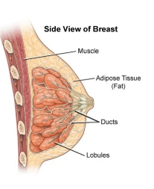
Introduction
What is Breast Cancer?
An abnormal, uncontrolled cell growth arising in breast tissue
Breast cancer is the second leading cause of death in women[1].
The most common breast cancer subtype is invasive ductal carcinoma (IDC) [4].
Invasive ductal carcinomas account for around 80% of all breast cancers [5]
Figure1:Structure of breast[1]

Slide 4
Problem Demonstration
The most commonly used early breast cancer diagnostic modalities are ultrasound and mammography.
Computer Aided Diagnosis (CAD) system using convolutional neural networks, deep learning methods has been applied on different breast cancer datasets.[3]
Deep learning approaches are so powerful in learning tasks and outperform the traditional methods that include features extraction and machine learning [3-7].
Despite the fact that this enhances performance, deep networks and massive inputs come with significant computational costs and parameters, which lengthen the time required for network training and tuning.

Slide 5
Research Objectives
The aim of my research is to solve those above problems by making a lightweight neural network .The objectives of this work are-
To classify positive Invasive Ductal Carcinoma(IDC +) & negative Invasive Ductal Carcinoma(IDC -) from Breast Histology Images.
To classify breast cancer, using Dilated Depthwise Seperable Convolution(DDSCNet)
To find out the effectiveness by comparing the proposed model with Normal CNN & Depthwise Seperable Convolution.

Slide 6
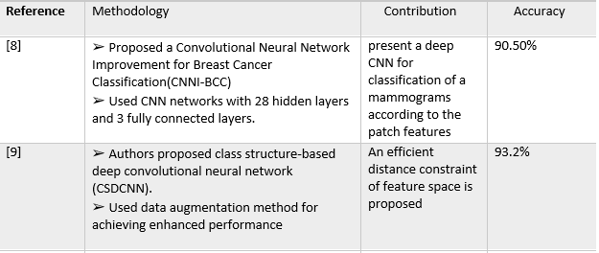
Related Works

Slide 7
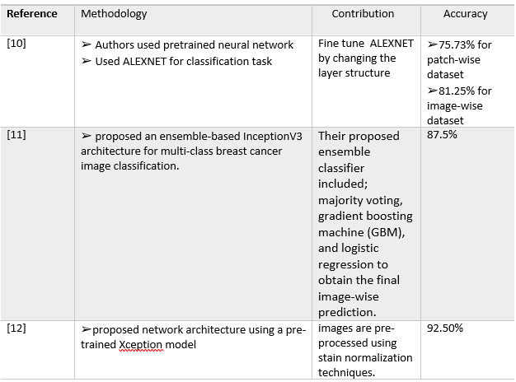
Related Works(Cont…)

Slide 8
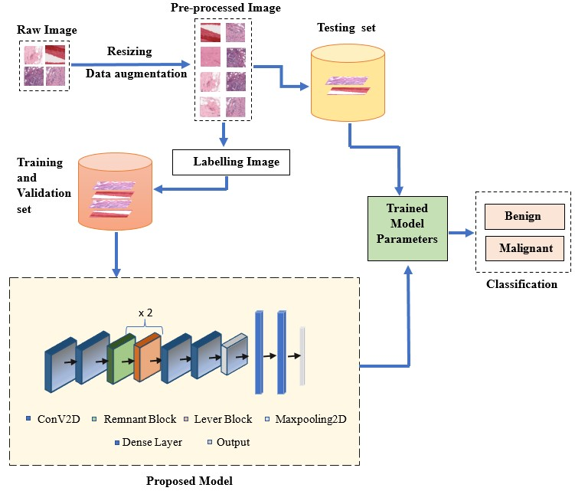
Research Methodology
Figure 2: Block Diagram of the proposed model

Slide 9
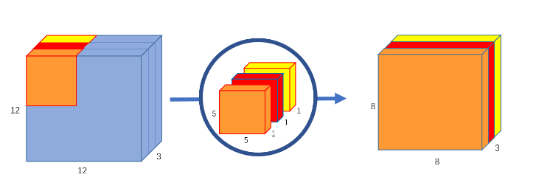
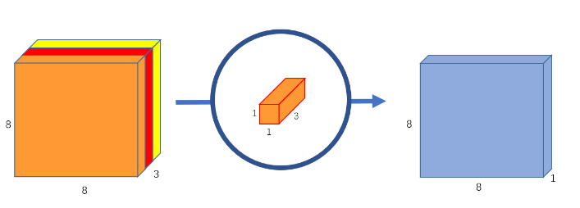
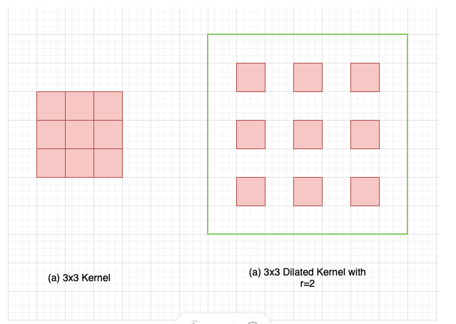
Research Methodology(Cont…)
Depthwise Separable Convolution
Dilated Convolution
Figure 3:Depthwise Convolution[15]
Figure 4:Pointwise Convolution[15]
Figure 5:Standard vs Dilated Kernel.[16]

Slide 10
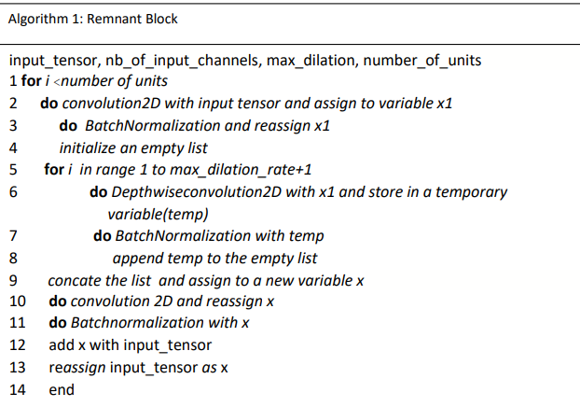
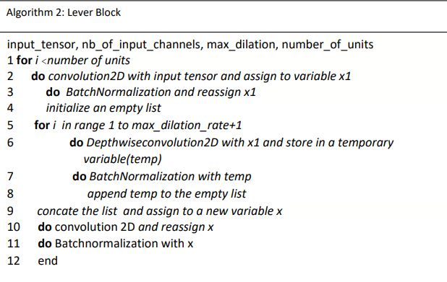
Research Methodology(Cont…)
Figure 6:Remnant Block
Figure 7: Lever Block

Slide 11
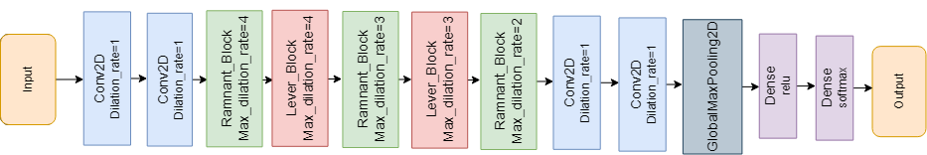
Research Methodology(Cont…)
Figure 8: Structure of Dilated Depthwise Seperable Convolution(DDSCNet)

Slide 12
Training Hyperparameters
Optimizer: Adaptive Moment Estimation (Adam)
Learning Rate: 0.001
Epochs: 50
Loss Function: Sparse Categorical Crossentropy

Slide 13
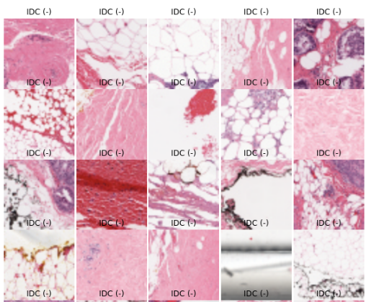
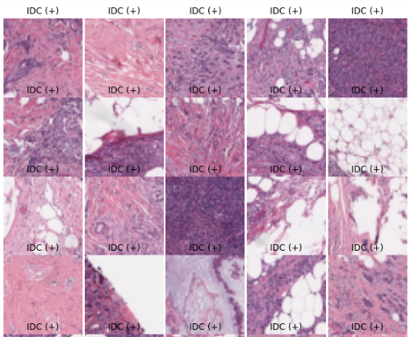
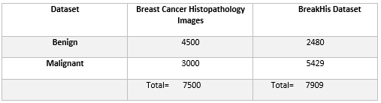
Dataset
IDC + samples
IDC - samples
Figure 10: Example of image IDC positive and IDC negative of the training set

Slide 14
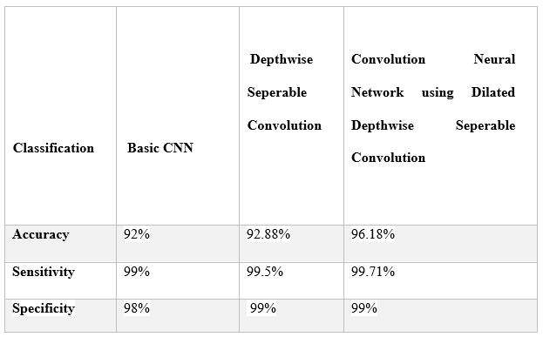
Results
Table 1: Overall experimental evaluation

Slide 15
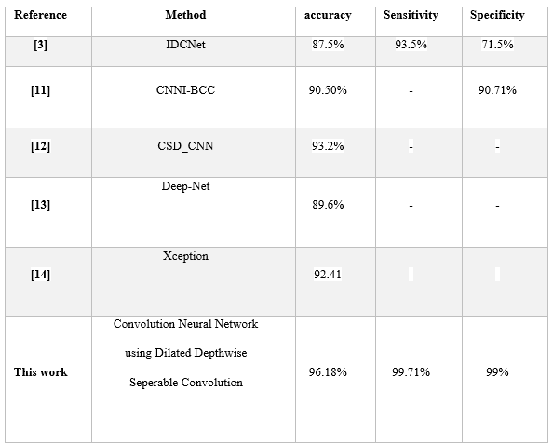
Results (Cont…)
Table 2: Comparison of proposed work with existing work

Slide 16
Conclusion
IDC breast cancer is a hazard to women all over the world and is to blame for the rise in the death rate of women.
Convolutional Neural Networks (CNNs) in particular and Deep Learning models in general have achieved significant success.
Although this improves performance, deep networks and enormous inputs have high computational costs and requirements, which extend the time needed for network training and tuning.
A lightweight neural network model named Dilated Depthwise Separable Convolutional Network (DDSCNet) is proposed using the Breast Cancer dataset.
Comparing the algorithms with Normal CNN & Depthwise Convolution, DDSCNet has the highest accuracy rate of 96.18%.

Slide 17
References
[1] https://www.cancer.org/cancer/breast-cancer/about/how-common-is-breast-cancer.html
[2] DeSantis, C., Siegel, R., Bandi, P., and Jemal, A., “Breast cancer statistics, 2011,” CA: A Cancer Journal for Clinicians 61(6), 408–418 (2011).
[3] Weston, J., Bengio, S., and Usunier, N., “Large scale image annotation: Learning to rank with joint wordimage embeddings,” Machine Learning 81, 21–35 (Oct. 2010).
[4] Seide, F., Li, G., and Yu, D., “Conversational speech transcription using context-dependent deep neural networks,” in [Proc Interspeech], 437–440 (2011).
[5] Glorot, X., Bordes, A., and Bengio, Y., “Domain adaptation for largescale sentiment classification: A deep learning approach,” in [Proceedings of the Twenty-eight International Conference on Machine Learning (ICML’11) ], 27, 97–110 (June 2011).
[6] Boulanger-Lewandowski, N., Bengio, Y., and Vincent, P., “Modeling temporal dependencies in highdimensional sequences: Application to polyphonic music generation and transcription,” in [Proceedings of the Twenty-nine International Conference on Machine Learning (ICML’12) ], ACM (2012).
[7] Ciresan, D. C., Meier, U., and Schmidhuber, J., “Multi-column deep neural networks for image classification,” in [Proceedings of the 2012 IEEE Conference on Computer Vision and Pattern Recognition (CVPR) ], CVPR ’12, 3642–3649, IEEE Computer Society, Washington, DC, USA (2012).
[8] Ting, Fung Fung, Yen Jun Tan, and Kok Swee Sim. "Convolutional neural network improvement for breast cancer classification." Expert Systems with Applications 120 (2019): 103-115.

Slide 18
References(Cont…)
[9] Han, Zhongyi, et al. "Breast cancer multi- classification from histopathological images with structured deep learning model." Scientific reports 7.1 (2017): 1-10.
[10] W. Nawaz, S. Ahmed, A. Tahir, and H. A. Khan, “Classification of breast cancer histology images using alexnet,” in International Conference Image Analysis and Recognition. Springer, 2018, pp. 869–876.
[11] Y. S. Vang, Z. Chen, and X. Xie, “Deep learning framework for multi-class breast cancer histology image classification,” in International Conference Image Analysis and Recognition. Springer, 2018, pp. 914– 922.
[12] Kassani, Sara Hosseinzadeh, et al. "Breast cancer diagnosis with transfer learning and global pooling." 2019 International Conference on Information and Communication Technology Convergence (ICTC). IEEE, 2019.
[13] Ciresan, D. C., Meier, U., and Schmidhuber, J., “Multi-column deep neural networks for image classification,” in [Proceedings of the 2012 IEEE Conference on Computer Vision and Pattern Recognition (CVPR) ], CVPR ’12, 3642–3649, IEEE Computer Society, Washington, DC, USA (2012).
[14] Yilmaz, Feyza, Onur Kose, and Ahmet Demir. "Comparison of two different deep learning architectures on breast cancer." 2019 Medical Technologies Congress (TIPTEKNO). IEEE, 2019
[15] https://towardsdatascience.com/a-basic-introduction-to-separable-convolutions-b99ec3102728
[16]https://towardsdatascience.com/a-primer-on-atrous-convolutions-and-depth-wise-separable-convolutions- 443b106919f5

Slide 19
THANK YOU

Slide 20
ANY QESTION?

